Slide 1

Traffic Safety
Merit Badge
Troop 344 and 9344
Pemberville, OH

Slide 2
Merit Badge Requirements
Do the following:
  Describe the top 10 mistakes new drivers frequently make. Name the two items you are required by law to carry with you whenever you operate a motor vehicle.
  Describe how alcohol and other drugs affect the human body and why a person should never drink and drive, or drive while under the influence of any mind-altering substances, including prescription drugs, cold medications, and illicit drugs. For the state where you live, find out what is the legal blood alcohol concentration and the consequences for driving while intoxicated or driving under the influence. Find out what the open-container law is in your state.
  Describe at least four factors to be considered in the design of a road or highway. Explain how roadside hazards and road conditions contribute to the occurrence and seriousness of traffic crashes.
  Explain why a driver who is fatigued or distracted should not operate a motor vehicle. List five common distractions, explain how driver distractions contribute to traffic accidents, and tell how drivers can minimize distractions. Describe how volunteer drivers can plan to be alert when transporting Scouting participants.

Slide 3
Merit Badge Requirements
Do the following:
  Demonstrate how to properly wear a lap or shoulder belt . Explain why it is important for drivers and passengers to wear safety belts at all times.
  List five safety features found in motor vehicles besides occupant restraint systems. Describe each safety feature, how each works, and how each contributes to safety.
Do the following :
  Using your family car or another vehicle, demonstrate that all lights and lighting systems in the vehicle are working. Describe the function and explain why each type of light is important to safe driving.
  Using your family car or another vehicle, demonstrate how to check tire pressure and identify the correct tire pressure for the vehicle. Explain why proper tire pressure is important to safe driving.
  Demonstrate a method to check for adequate tire tread. Explain why proper tire tread is important to safe driving.
  Demonstrate with a smear-and-clear test if the windshield wiper blades will clear the windshield completely or need to be replaced. Describe instances in good and bad weather when windshield washers are important to safe driving.

Slide 4
Merit Badge Requirements
Do the following:
  In a location away from traffic hazards, measure with a tape measure - not in a car - and mark off with stakes the distance that a car will travel during the time needed for decision and reaction, and the braking distances necessary to stop a car traveling 30, 50, and 70 miles per hour on dry, level pavement. Discuss how environmental factors such as bad weather and road conditions will affect the distance.
  Describe the difference in nighttime visibility between a properly lit bicycle and rider (or a pedestrian) wearing reflective material and a bicycle and rider with no lights (or a pedestrian) dressed in dark clothing, without reflective material.
  Explain how color and shape are used to help road users recognize and understand the information presented on traffic and roadway signs. Explain the purpose of different types of signs, signals, and pavement markings.
  Describe at least three examples of traffic laws that apply to drivers of motor vehicles and that bicyclists must also obey.

Slide 5
Merit Badge Requirements
Do ONE of the following:
  Interview a traffic law enforcement officer in your community to identify what three traffic safety problems the officer is most concerned about. Discuss with your merit badge counselor possible ways to solve one of those problems.
  Using the Internet (with your parent's permission), visit five websites that cover safe driving for teenagers. Then, in a group session with at least three teenagers and your counselor, discuss what you have learned.
  Initiate and organize an activity or event to demonstrate the importance of traffic safety.
  Accompanied by an adult and a buddy, pick a safe place to observe traffic at a controlled intersection (traffic signal or stop sign) on three separate days and at three different times of the day, for 30 minutes on each visit. At this intersection, survey violations that might occur. These violations could include (but are not limited to) running a red light or stop sign, speeding, using a cell phone while driving, or occupants not wearing their seat belts. Count the number of violations. Record in general terms the approximate age of the people you observed. Keep track of the total number of vehicles observed so that you can determine the percentage of compliance vs. violations. Discuss your findings with your merit badge counselor.

Slide 6

Requirement 1a
Describe the top 10 mistakes new drivers frequently make. Name the two items you are required by law to carry with you whenever you operate a motor vehicle.

Slide 7
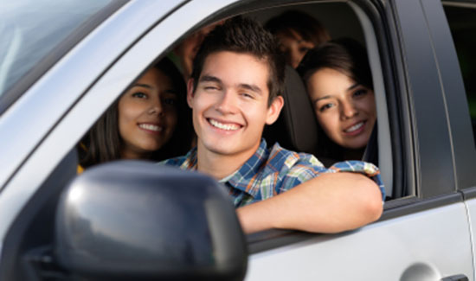
Requirement 1a
Top 10 Mistakes Young Drivers Make
  Overconfidence.
  Being distracted behind the wheel. Cell phones, music, food and even text messages can pose serious distractions to drivers.
  Taking too many risks.
  Speeding.
  Overcrowding the car.
  Driving under the influence.
  Following too closely.
  Driving unbuckled.
  Not being able to handle emergencies.
  Choosing the wrong car and not maintaining it.

Slide 8
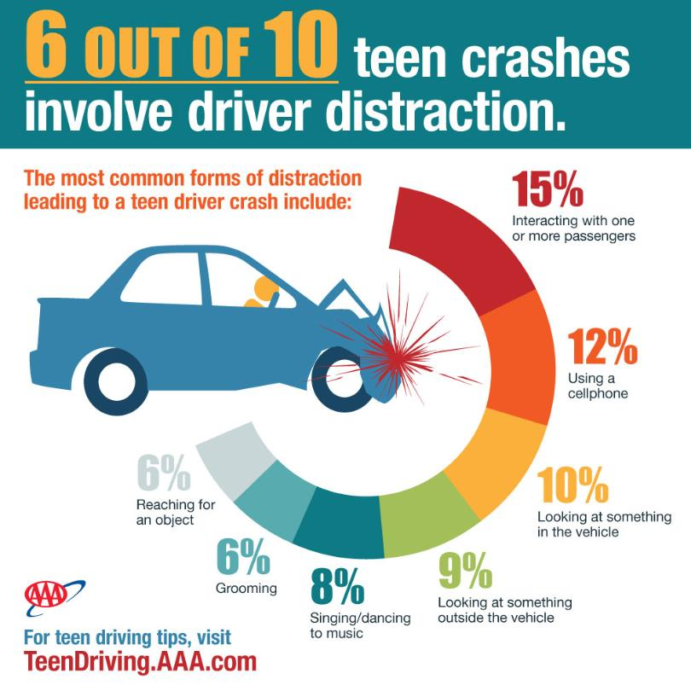
Requirement 1a

Slide 9
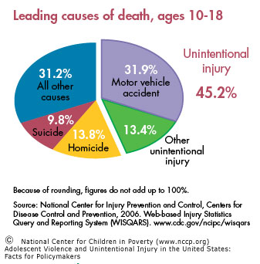
Requirement 1a

Slide 10
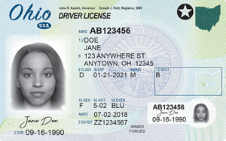
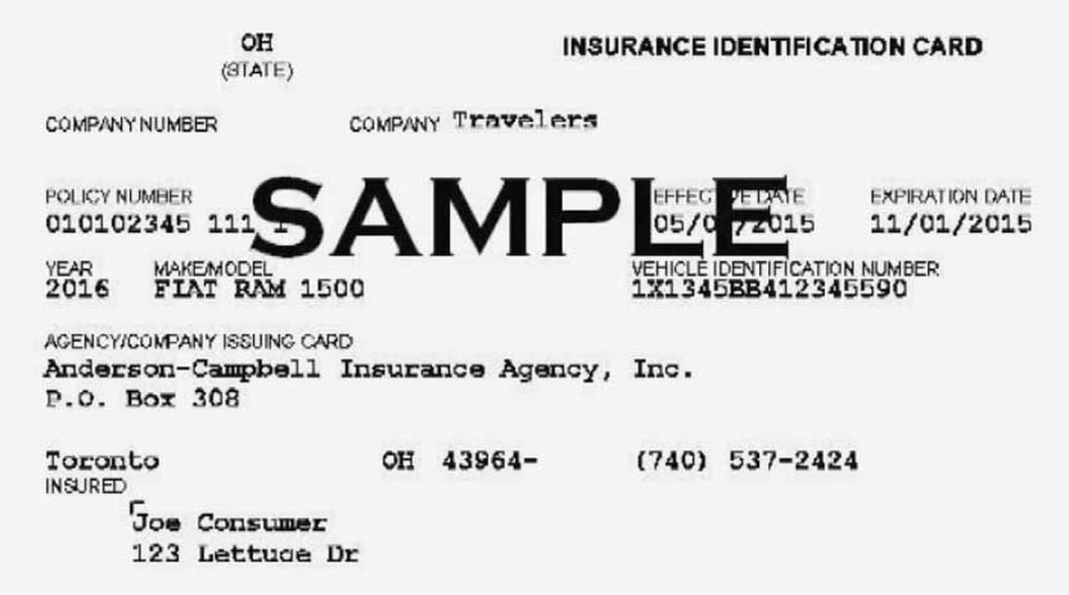
Requirement 1a
Two items you are required by law to carry with you whenever you operate a motor vehicle are:
A current drivers license from the State where you live.
Proof of insurance on your vehicle.

Slide 11

Requirement 1b
Describe how alcohol and other drugs affect the human body and why a person should never drink and drive, or drive while under the influence of any mind-altering substances, including prescription drugs, cold medications, and illicit drugs. For the state where you live, find out what is the legal blood alcohol concentration and the consequences for driving while intoxicated or driving under the influence. Find out what the open-container law is in your state.

Slide 12
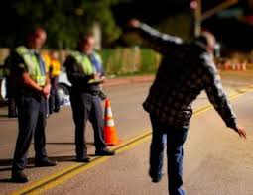
Requirement 1b
Short-term effects of alcohol can include:
  Lowered inhibitions, leading to poor social judgment.
  Trouble concentrating.
  Loss of coordination.
  Loss of critical judgement.
  Dulled perception, especially vision.
  Mood swings.
  Slower reaction time.
  Raised blood pressure.
  Passing out.
  Vomiting.

Slide 13
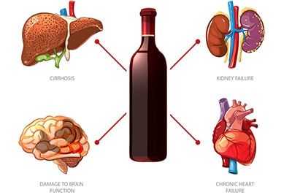
Long-term effects of excessive drinking may include:
  Diminished gray matter and white matter in the brain.
  Memory loss.
  Loss of attention span.
  Trouble learning.
  High blood pressure.
  Stroke.
  Kidney failure.
  Cirrhosis of the liver.

Slide 14
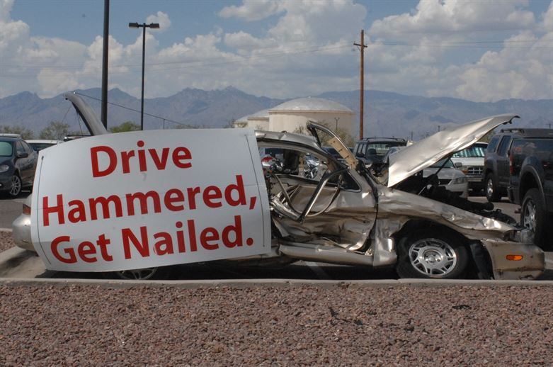
Requirement 1b
Dangers of Drinking and Driving.
  Any amount of alcohol in your bloodstream can impact your driving ability.
  The effects of alcohol put you at risk for causing an accident or highway injury.
  Safe driving requires the ability to concentrate, make good judgements and quickly react to situations.

Slide 15
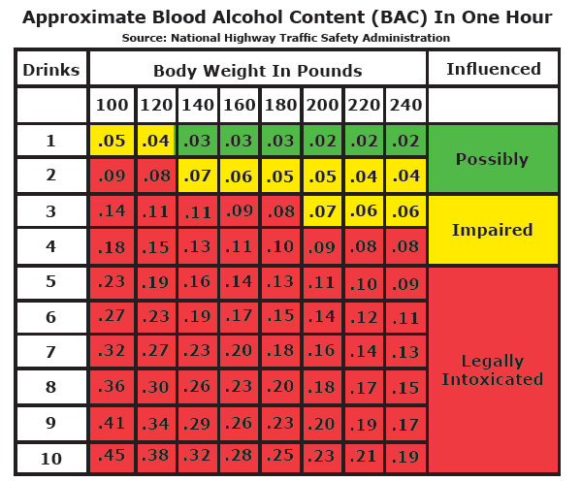
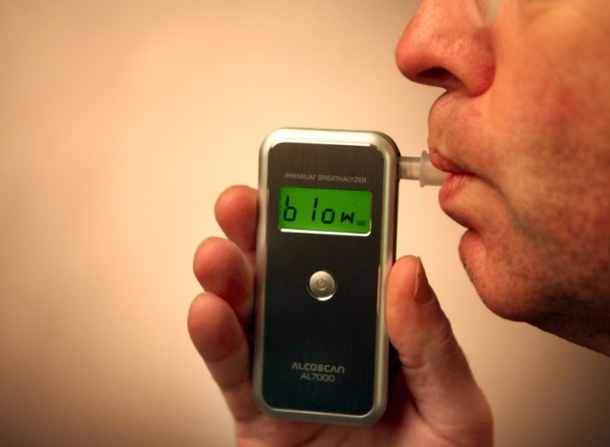
Requirement 1b
Blood Alcohol Concentration is the amount of alcohol in the bloodstream.
  It is measured by the weight of the alcohol in relation to the blood.
  BAC can be measured by breath, blood, or urine tests.
When your BAC is 0.08% or higher, you're considered legally impaired in all 50 States in the U.S.

Slide 16
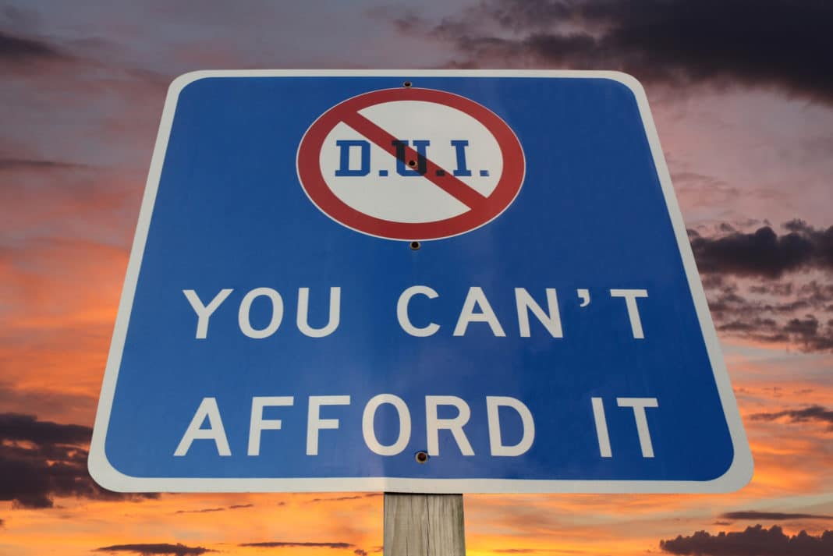
Requirement 1b
Short Term Consequences of a DUI.
  License suspension for 30 days to a year.
  Many states have mandatory jail time for a first DUI conviction.
  Many states allow for temporary or even permanent seizures or confiscation of a DUI offender’s vehicle.
  DUI convictions generally carry fines and fees of several hundred dollars or more.
  You will have to pay for and complete an alcohol and drug education program, usually referred to as drunk driving school to get your license back.

Slide 17
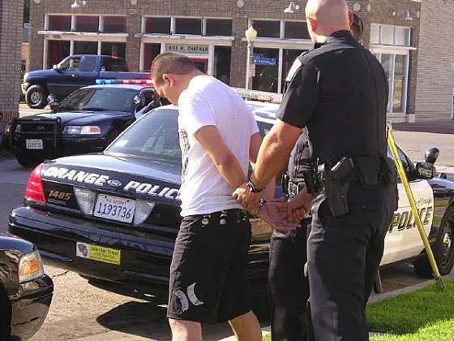
Requirement 1b
Long Term Consequences of a DUI
  Driver’s License Revocation for up to two years for a first conviction.
  Most employers conduct criminal background checks before they hire job applicants and a DUI conviction could thwart your efforts to secure a job.
  A DUI arrest and conviction can wreak havoc on your work schedule and put your current job at risk.
  Convicted DUI drivers are considered “high-risk” drivers by insurance companies insurance rates may double or triple for at least several years.
  Many schools do not accept students who have DUI convictions on their records and scholarships may be revoked or denied.

Slide 18
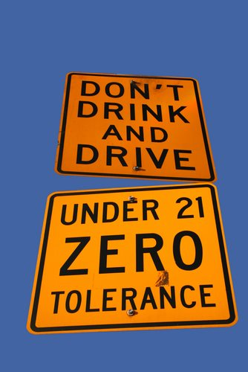
Requirement 1b
Zero Tolerance Laws makes it illegal for any driver younger than 21 to operate a vehicle with any type of blood alcohol count (BAC).
Nearly one-third of all deaths of 15- to 20-year-olds are the result of a motor vehicle crash and about 35 percent of those fatalities are alcohol-related

Slide 19
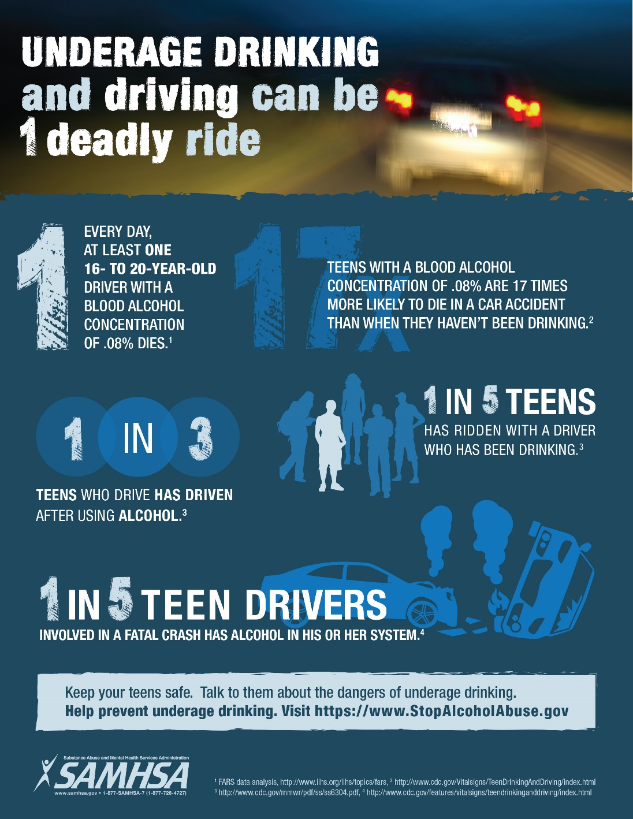
Requirement 1b

Slide 20
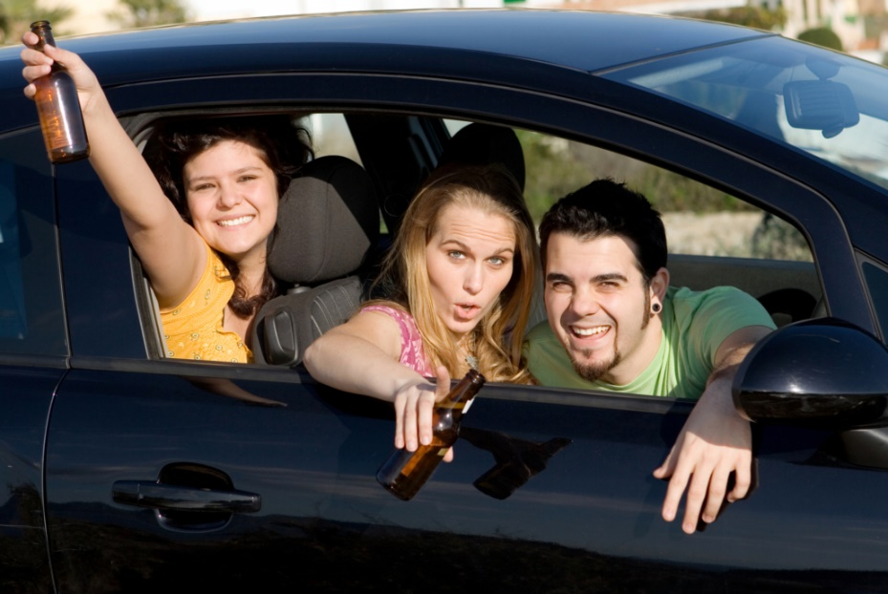
Requirement 1b
Open Container Law
  Most States have open-container laws that prohibit the driver or other occupants of a vehicle from having open containers of alcohol in the passenger compartment of the vehicle.
  Penalties can include fines, community service, and jail.

Slide 21
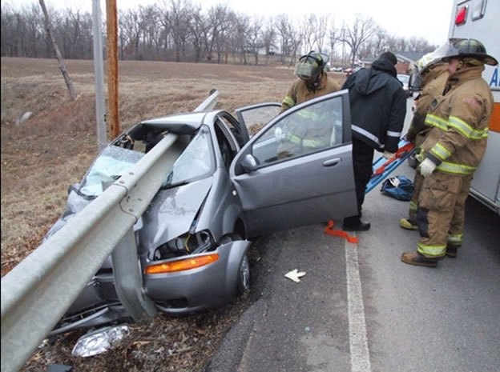
Requirement 1b
The Bottom Line: Alcohol and Drugs Kill!

Slide 22
Requirement 1c
Describe at least four factors to be considered in the design of a road or highway. Explain how roadside hazards and road conditions contribute to the occurrence and seriousness of traffic crashes.

Slide 23
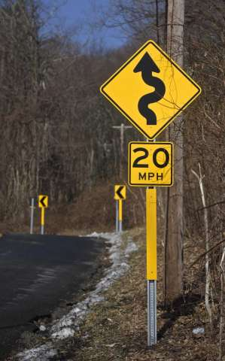
Requirement 1c
Four Factors to Consider in the Design of a Roadway.
  Uniformity – Roads should have the same type of signage from State to State.
  Speed – Determine safe speeds for curves, passing, intersections.
  Roadside Hazards – Does it need a traffic light, guard rails, signage.
  Roadway Safety Features – Reflective signs, lighting, crosswalks, painted lanes, passing lanes, rumble strips.

Slide 24
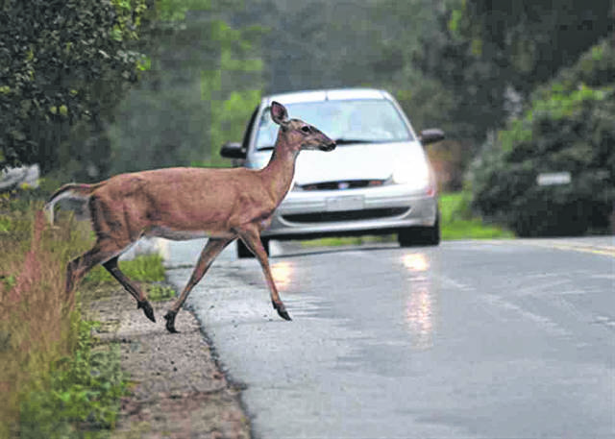
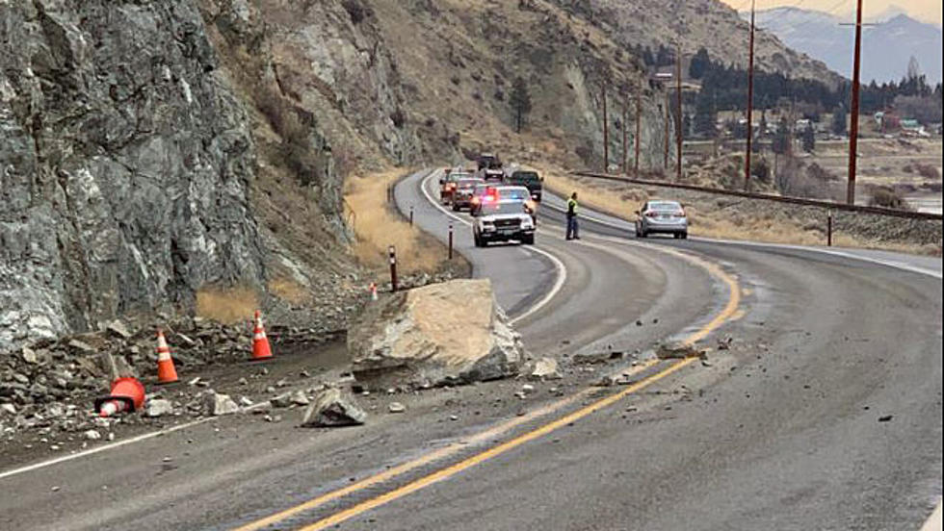
Requirement 1c
Roadside Hazards
  Unexpected hazards can cause drivers to lose control of their vehicles. This happens quite frequently when a driver swerves to avoid a hazard. The driver loses control of the vehicle, creating a situation that results in a crash.

Slide 25
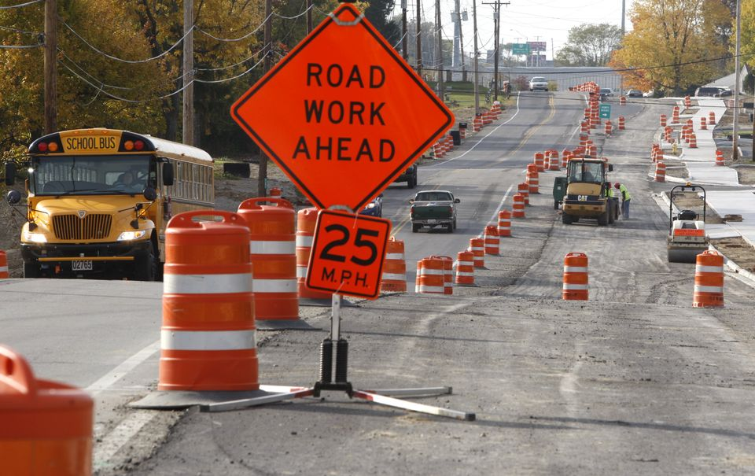
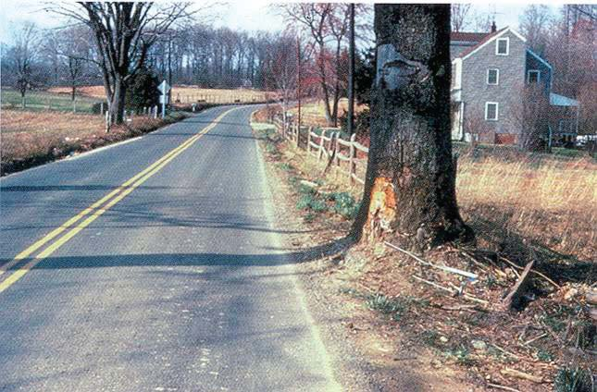
Requirement 1c
Roadside Hazards
For more than one-third of all highway fatalities, the side of the road is a contributing factor.
Various factors can cause a vehicle to leave the roadway, including distractions, vehicle malfunctions, traffic situations, and poor road conditions.
Many roads are lined with trees, signs, posts, guardrails, or other structures that can mean death or injury for a motorist.

Slide 26
Requirement 1d
Explain why a driver who is fatigued or distracted should not operate a motor vehicle. List five common distractions, explain how driver distractions contribute to traffic accidents, and tell how drivers can minimize distractions. Describe how volunteer drivers can plan to be alert when transporting Scouting participants.

Slide 27
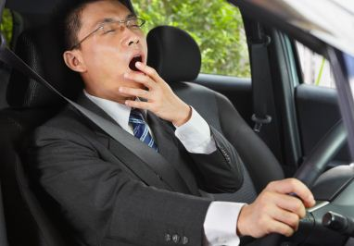
Requirement 1d
Impact of Drowsiness on Driving
  Driving while drowsy is similar to driving under influence of alcohol:
  Drivers’ reaction times, awareness of hazards, and ability to sustain attention all worsen the drowsier the driver is
  Driving after going more than 20 hours without sleep is the equivalent of driving with a blood-alcohol concentration of 0.08% – the U.S. legal limit
  You are three times more likely to be in a car crash if you are fatigued

Slide 28
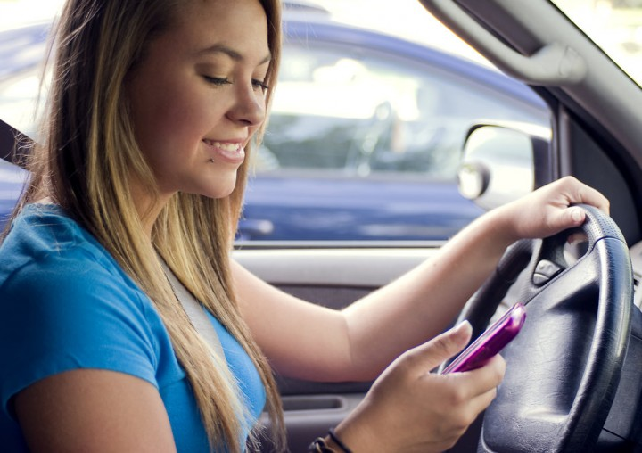
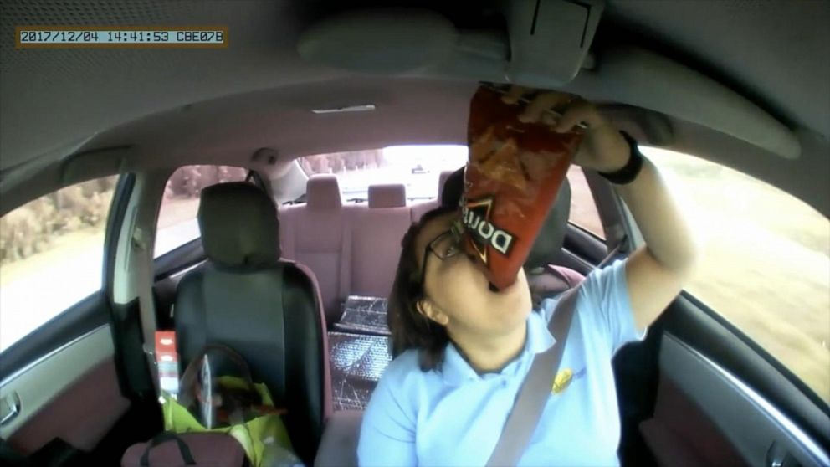
Requirement 1d
The most common causes of distracted driving.
Talking and texting. People who use their cell phones to talk or text while driving are by far the most common reason for distracted driving accidents.
Eating or drinking.
Adjusting music or controls.
Applying makeup.
Talking to passengers.
Not looking at the road.
Handling children or pets.
Zoning out.

Slide 29
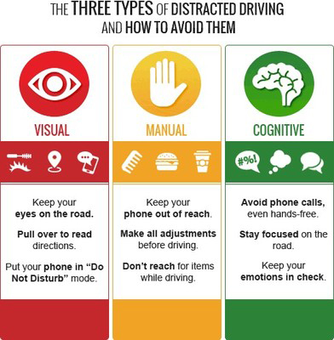
Requirement 1d
A driver must always remain alert and be ready to deal with the unexpected.
It is essential to give driving your full attention and keep all distractions to a minimum.

Slide 30
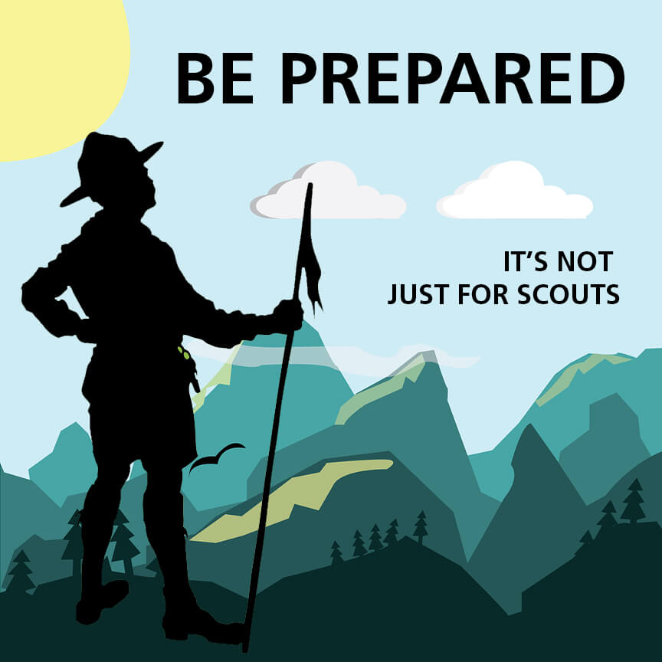
Requirement 1d
Volunteers Driving Scouts
  Be Prepared; know where you are going.
  Pull over to use the cell phone.
  Don’t text or adjust the radio.
  Get plenty of rest; don’t drive tired.
  Stop and get out of the vehicle to eat.
  Passengers can make calls or assist to decrease any unnecessary distractions.
  As a passenger, “Don’t distract the driver.”

Slide 31
Requirement 2a
Demonstrate how to properly wear a lap or shoulder belt . Explain why it is important for drivers and passengers to wear safety belts at all times.

Slide 32
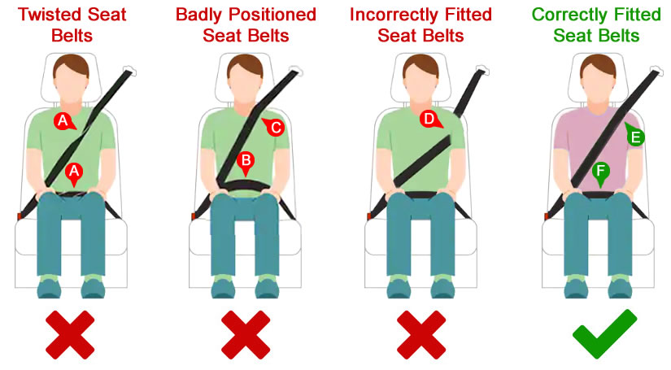
Requirement 2a
How to properly wear a seatbelt:

Slide 33
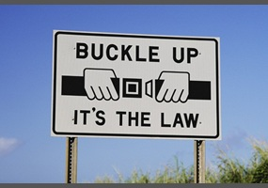
Requirement 2a
Why it is important to wear a seatbelt.
Among drivers and front-seat passengers, seat belts reduce the risk of death by 45%, and cut the risk of serious injury by 50%.
Seat belts prevent drivers and passengers from being ejected during a crash.
People not wearing a seat belt are 30 times more likely to be ejected from a vehicle during a crash.
It’s the Law.

Slide 34
Requirement 2b
List five safety features found in motor vehicles besides occupant restraint systems. Describe each safety feature, how each works, and how each contributes to safety.

Slide 35
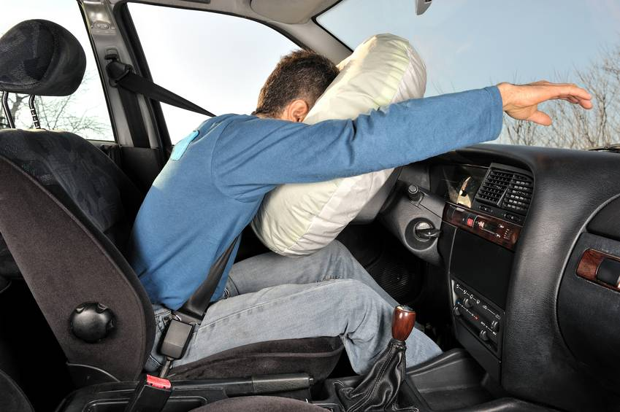
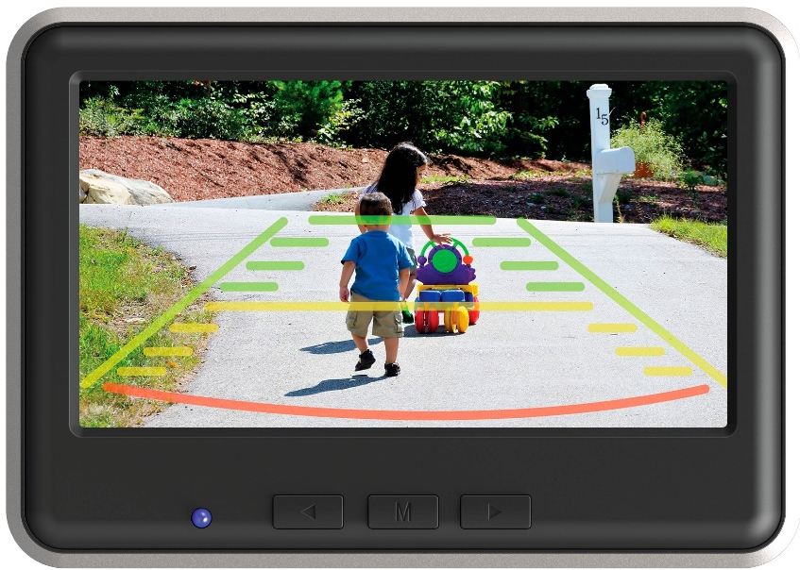
Requirement 2b
Safety Features in Motor Vehicles
Air Bags – A car’s airbags will deploy in a crash and cushion both the driver and passengers from common impact points, like the steering wheel, dash, and sides of the vehicle.
Traction and Stability Control – helps the vehicle’s tires from losing contact with the road to prevent sliding or skidding.
Rear-view cameras – Improves the rearward view and can assist drivers in detecting persons or objects in the path of a backing vehicle.

Slide 36
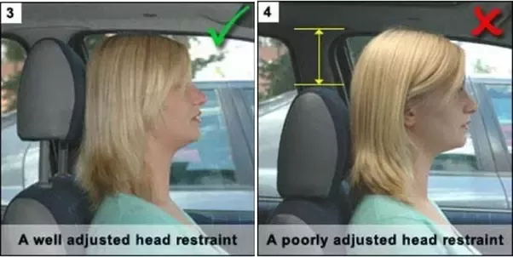
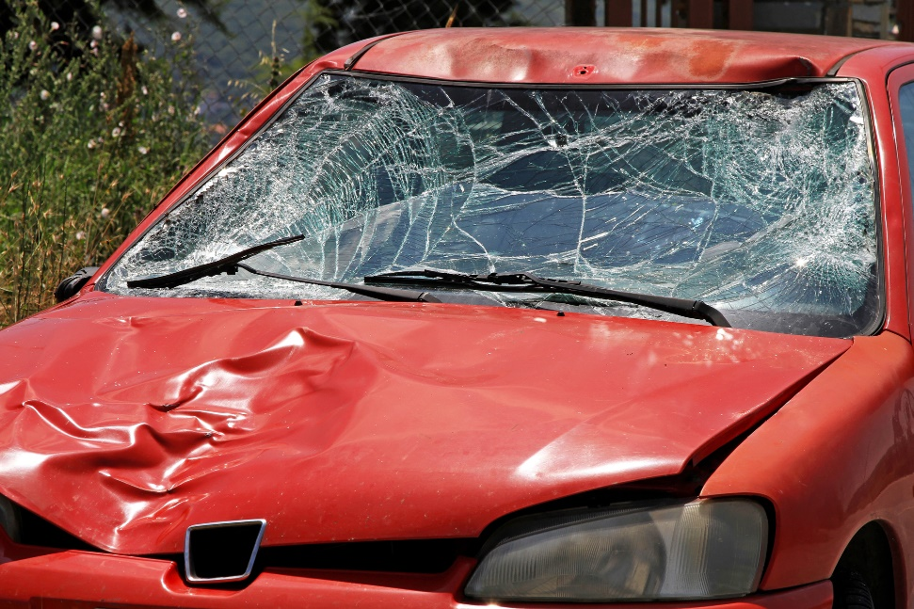
Requirement 2b
Safety Features in Motor Vehicles
Head Restraints – Designed to prevent an occupants head from being snapped back (whiplash) if a vehicle is rear-ended.
Antilock brakes – Prevents the wheels from locking when you hit the brakes quickly. Locked wheels can cause the car to spin out on a slippery service, making it impossible for you to steer.
Shatter resistant glass. Shatter resistant glass provides a windshield that breaks into numerous, harmless pieces in the event of an accident.

Slide 37
Requirement 3a
Using your family car or another vehicle, demonstrate that all lights and lighting systems in the vehicle are working. Describe the function and explain why each type of light is important to safe driving.

Slide 38
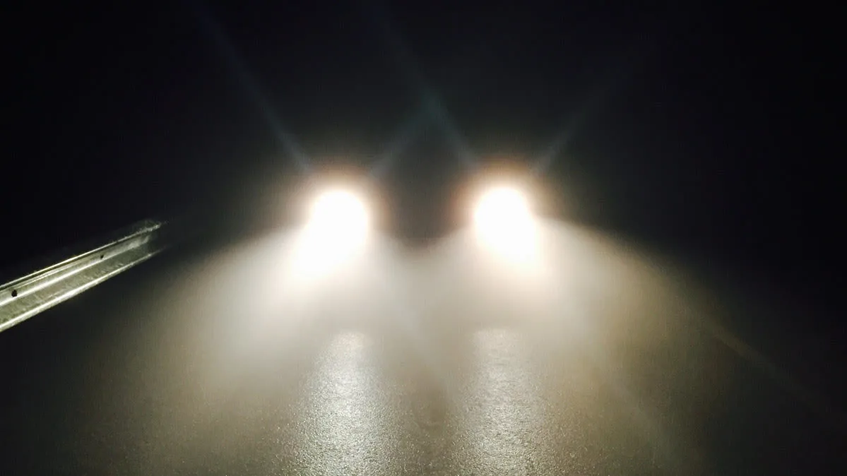
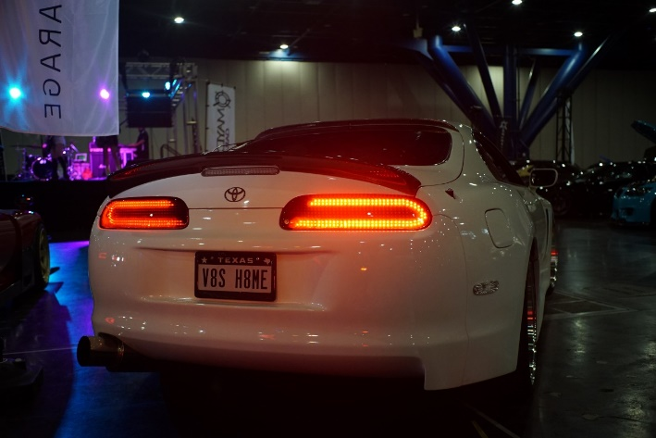
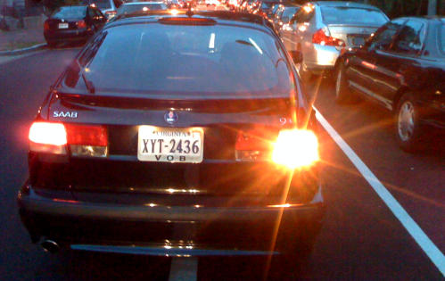
Requirement 3a
Vehicle Lighting Systems
Headlights – located on the front of vehicles are there to enable drivers to see at night. They are also used to notify other drivers of your presence in foggy conditions when visibility may be very low.
Taillights – show the rear edge of the vehicle to allow other drivers to appropriately gauge the size and shape of the car. In addition, they allow other vehicles to see the car in inclement weather such as rain or snow.
Turn Signals – let other motorists know your intentions while driving a vehicle when changing lanes, turning, or making other maneuvers while driving.

Slide 39
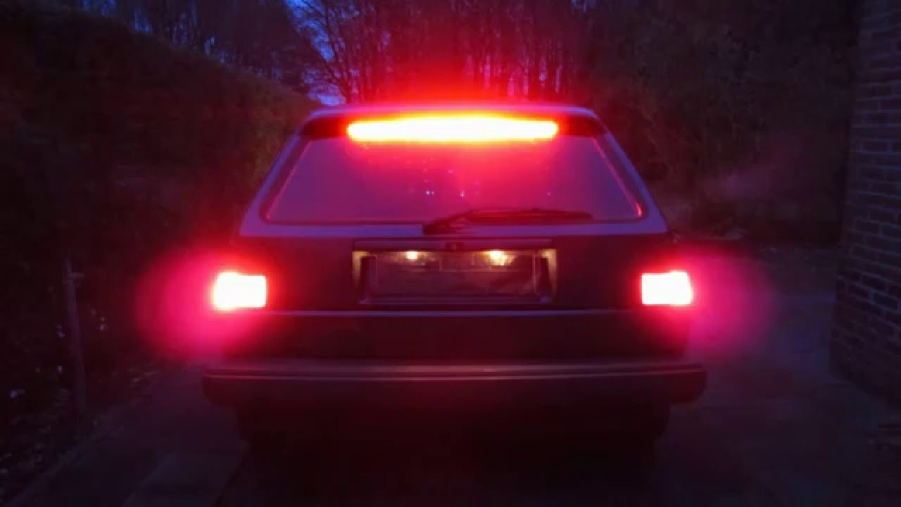
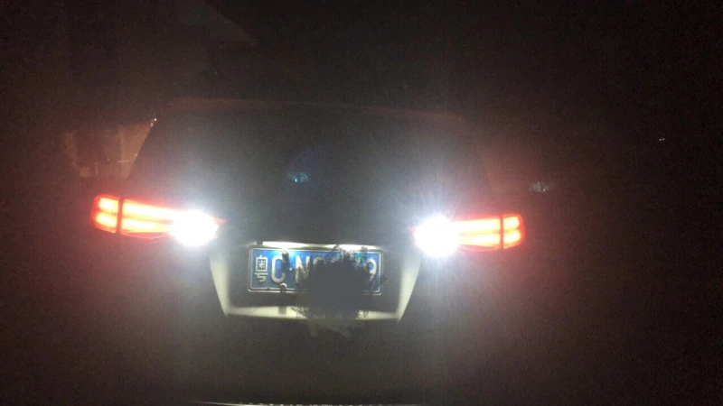
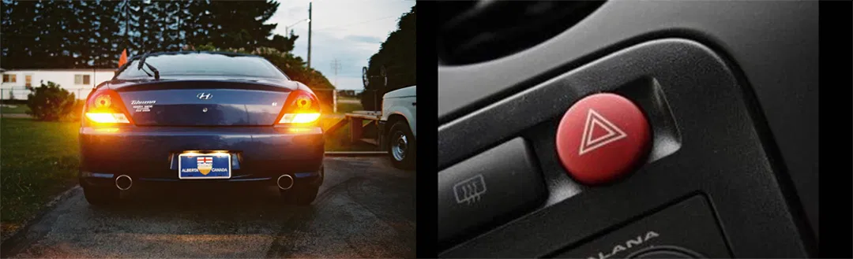
Requirement 3a
Vehicle Lighting Systems
Brake Lights – warn drivers behind you when you're slowing down.
Back-up Lights – are used to warn other vehicles and people around the car that the vehicle is about to move backwards. The reverse lights also provide some illumination when the car is backing up.
Hazard Lights – are a pair of intermittent flashing indicator lights that flash in unison to warn other drivers that the vehicle is a temporary obstruction.

Slide 40
Requirement 3b
Using your family car or another vehicle, demonstrate how to check tire pressure and identify the correct tire pressure for the vehicle. Explain why proper tire pressure is important to safe driving.

Slide 41
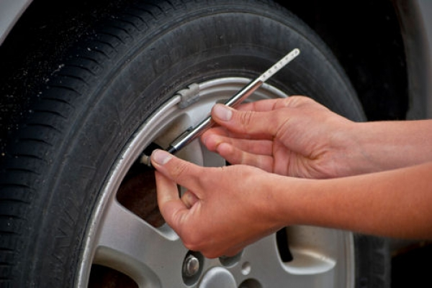
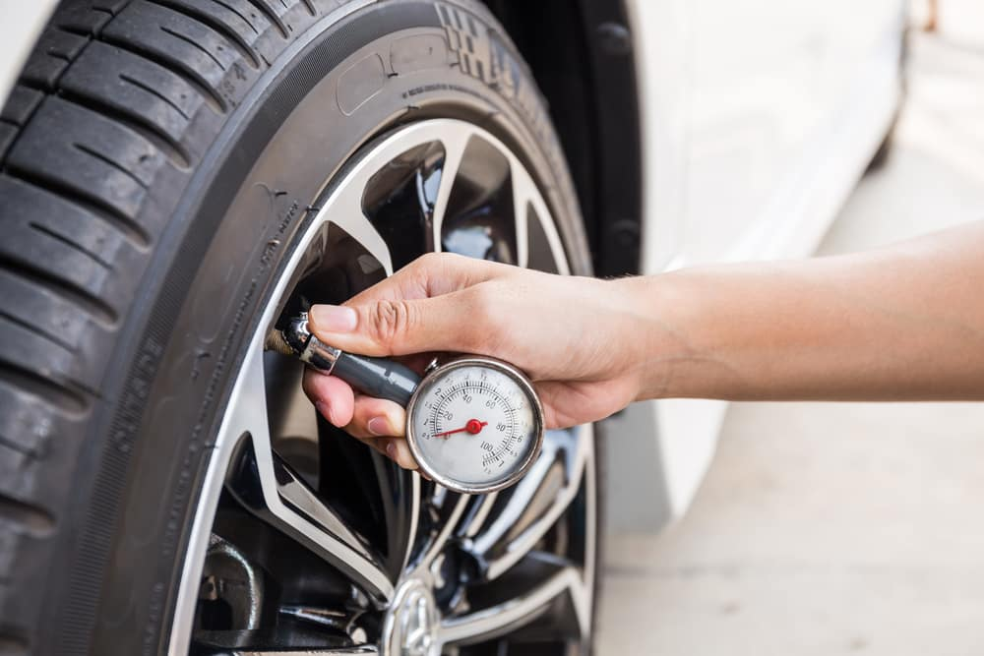
Requirement 3b
How to Check Tire Pressure.
Unscrew the cap on the valve stem.
Press the tire gauge against the valve stem making a "flat" connection that seals completely. Swiftly remove the gauge from the tire's valve stem after the stick pops or the dial moves.
Read the gauge to determine if the pressure is within recommended limits.
If the tire pressure is lower than recommended, inflate the tire with an air compressor commonly found at gas stations and service centers.
After adding air, repeat steps 2 and 3 to determine if the tire pressure is now within limits.
If the tire pressure is higher than recommended, release air from the tire. Most tire pressure gauges have a small nub on the backside that is designed to be pressed into the center of the valve stem, releasing air.
If you've released some air, repeat steps 2 and 3 to determine if you need to add or remove air from the tire.

Slide 42
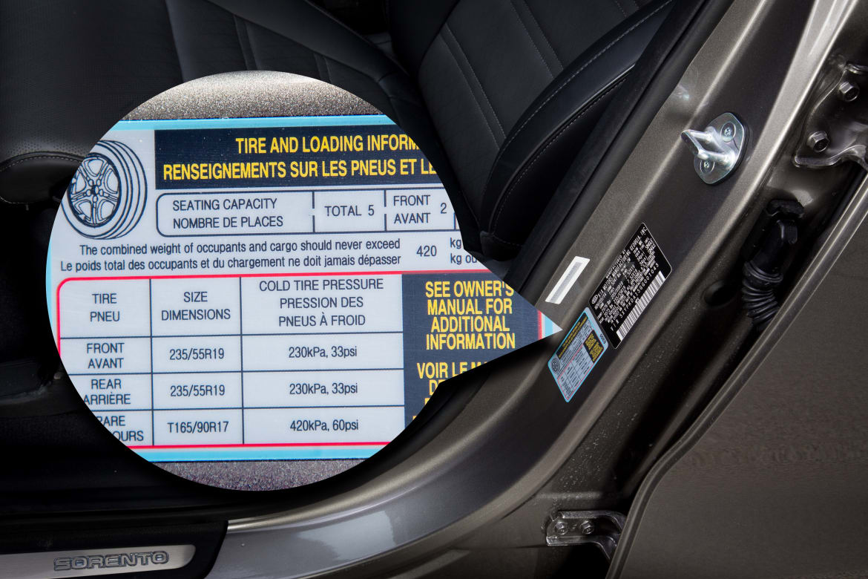
Requirement 3b
How to identify the correct tire pressure for a vehicle.
You will find the manufacturer's optimum or recommended tire pressure for your car on a sticker in the door jamb, or in your owner's manual.

Slide 43
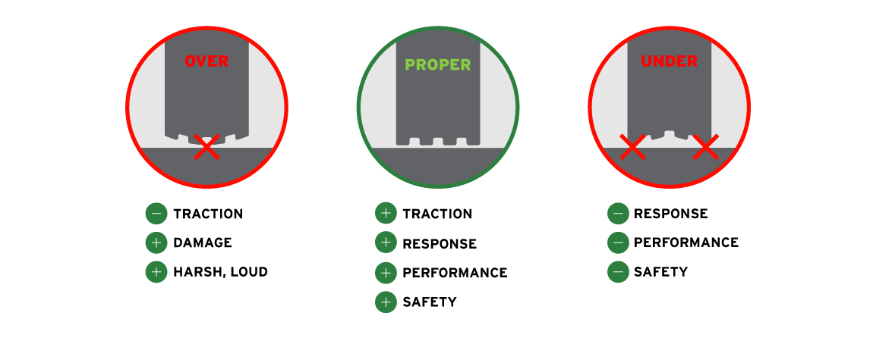
Requirement 3b
Why is proper tire pressure important for safe driving?
Appropriately inflated tires provide better vehicle handling.
  When tire pressure is too low or too high the vehicle is not able to maintain the right amount of traction on the road, and driving gets more dangerous.
Under or over-inflated tires can increase tire wear.
Proper tire inflation improves fuel efficiency.

Slide 44
Requirement 3c
Demonstrate a method to check for adequate tire tread. Explain why proper tire tread is important to safe driving.

Slide 45
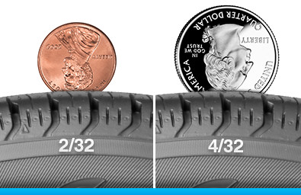
Requirement 3c
Checking Adequate Tire Tread.
The penny test and quarter test for tire tread depth both work the same way: stick the coin into your tire's tread head-first and if you can see the top of the president's head then you need new tires.
The quarter test gives a depth of 4/32 and is replacing the penny test which gives a depth of 2/32.
Minimum legal tread depth in most states is 2/32.
Unfortunately, 2/32 may be too late if you drive in rain or snow.
Using the quarter test informs you of the need to replace your tires before it becomes too dangerous.

Slide 46
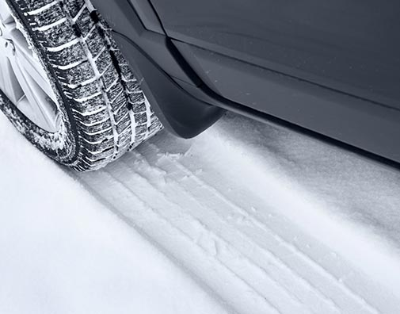
Requirement 3c
Tire Tread Depth is Very Important For Safe Driving.
A tire that lacks the proper tread depth won't be able to properly grip the road.
A tire that can't hold onto the road will slide and take longer to brake.
Without the proper tread depth, your chances of getting into an accident also increase.

Slide 47
Requirement 3d
Demonstrate with a smear-and-clear test if the windshield wiper blades will clear the windshield completely or need to be replaced. Describe instances in good and bad weather when windshield washers are important to safe driving.

Slide 48
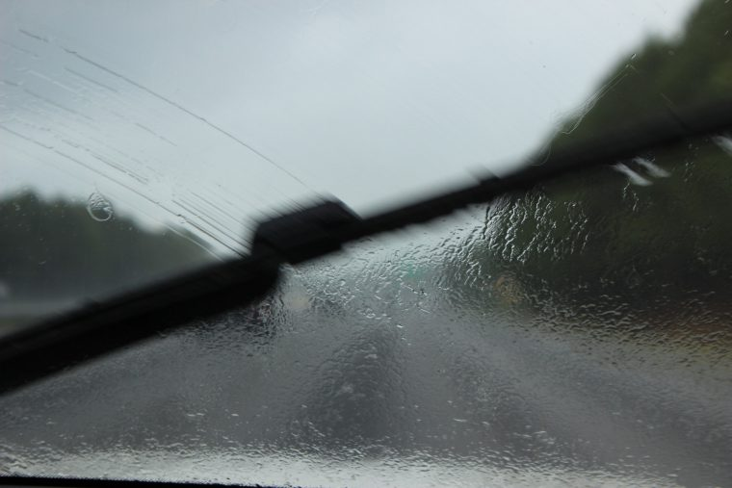
Requirement 3d
Windshield wipers are important for providing a clear, unobstructed view.
Impaired vision while driving is extremely dangerous -and is a contributing factor in as many as 90% of all accidents.
The main purpose of a windshield wiper blade is to keep your vision clear while driving.
Faulty wiper blades can be ineffective and even smear your windshield, potentially creating visibility issues.

Slide 49
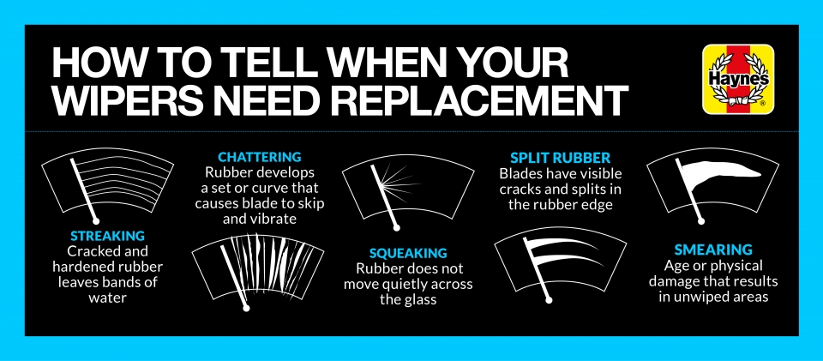
Requirement 3d
Wiper blades should be replaced every six months to a year or as soon as you notice a difference in driving visibility.
When wiper blades no longer make proper contact with the windshield surface, they can begin to squeak, chatter, skip, smear or streak reducing driving visibility.

Slide 50
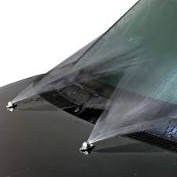
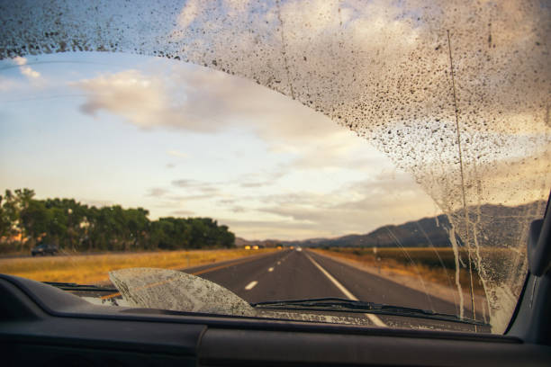
Requirement 3d
Windshield washer fluid is used in cleaning the windshield of road grime or salt spray with the windshield wiper while the vehicle is being driven in order to improve visibility.

Slide 51
Requirement 4a
In a location away from traffic hazards, measure with a tape measure - not in a car - and mark off with stakes the distance that a car will travel during the time needed for decision and reaction, and the braking distances necessary to stop a car traveling 30, 50, and 70 miles per hour on dry, level pavement. Discuss how environmental factors such as bad weather and road conditions will affect the distance.

Slide 52
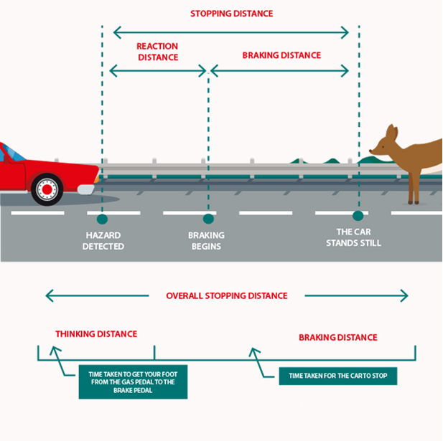
Requirement 4a

Slide 53
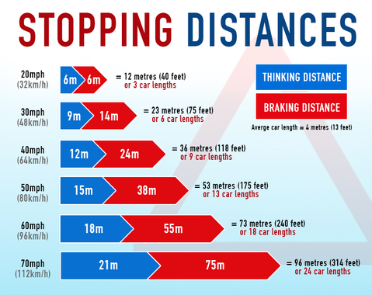
Requirement 4a

Slide 54

Requirement 4a

Slide 55
Requirement 4b
Describe the difference in nighttime visibility between a properly lit bicycle and rider (or a pedestrian) wearing reflective material and a bicycle and rider with no lights (or a pedestrian) dressed in dark clothing, without reflective material.

Slide 56


Requirement 4b
Help other road users to see you.
When it is dark, use reflective materials (example. armbands, sashes, waistcoats, jackets, footwear), which can be seen by drivers using headlights up to three times as far away as non-reflective materials.

Slide 57

Requirement 4b
Biking at night is much more dangerous than riding during the day.
If you must ride after dark, make sure your bike has reflectors and a bright light on both the front and rear.
Wear reflective clothing, and don't assume that motorists can see you.

Slide 58
Requirement 4c
Explain how color and shape are used to help road users recognize and understand the information presented on traffic and roadway signs. Explain the purpose of different types of signs, signals, and pavement markings.

Slide 59


Requirement 4c
Shape and Color of Traffic Signs
Regulatory Signs
Warning Signs

Slide 60


Requirement 4c
Shape and Color of Traffic Signs
Guide Signs
Service Signs

Slide 61

Requirement 4c
Shape and Color of Traffic Signs
Work Zone Signs

Slide 62

Requirement 4c
The traffic light is one of the most common signals on the road. Traffic signals control the flow of traffic through intersections. Red means stop, yellow means caution, and green means go.

Slide 63

Requirement 4c
Pavement Markings
Yellow lines separate traffic in opposite directions and white lines separate traffic lanes moving in the same direction.

Slide 64

Requirement 4c
Pavement Markings
A normal broken yellow line marks a two-direction passing zone. Traffic traveling in either direction may pass other vehicles with care and when the way ahead is clear.

Slide 65

Requirement 4c
Pavement Markings
Where there is one solid yellow line and one broken yellow line, traffic traveling adjacent to the broken line may pass other vehicles with care, but traffic traveling adjacent to the solid line is prohibited from passing.

Slide 66

Requirement 4c
Pavement Markings
A center lane with a normal broken yellow line and a normal solid yellow line on each side indicate a two-way left-turn lane. This lane is used by traffic in either direction as part of a left-turn maneuver.

Slide 67

Requirement 4c
Pavement Markings
Dotted white lane lines separate a through lane from deceleration or acceleration lane, or a through lane that becomes a mandatory exit or turn lane.
A normal broken white line separates lanes where you are permitted to change lanes. Cross the lane line markings with care.
When normal or wide solid white lines are painted between travel lanes, you should stay in your lane. The solid line means that crossing the line marking is discouraged. You should only change lane when it is necessary to avoid an incident.
The solid white lane line marking is often used to separate a through lane from an added mandatory turn lane at intersections. Once you have entered your lane, don’t change your mind in the last second.

Slide 68
Requirement 4d
Describe at least three examples of traffic laws that apply to drivers of motor vehicles and that bicyclists must also obey.

Slide 69

Requirement 4d
All states require cyclists to follow the basic rules of the road when riding a bicycle on a roadway.
Like any vehicle operator, a bicyclist must ride with traffic, obey basic traffic laws, stop at stop signs and red lights, and follow all traffic control devices.
Cyclists should communicate intentions to drivers as much as possible using hand signals whenever turning or stopping, but assume that those signals might not be understood by every driver.

Slide 70

Requirement 5a
Do ONE of the following:
  Interview a traffic law enforcement officer in your community to identify what three traffic safety problems the officer is most concerned about. Discuss with your merit badge counselor possible ways to solve one of those problems.

Slide 71



Requirement 5a
Traffic safety problems
Distracted driving
Speeding
Seatbelt use
Driving under the influence
Failure to obey traffic signals or yield right of way.
Driving to close.

Slide 72

Requirement 5b
Do ONE of the following:
  Using the Internet (with your parent's permission), visit five websites that cover safe driving for teenagers. Then, in a group session with at least three teenagers and your counselor, discuss what you have learned.

Slide 73

Requirement 5b
Five Websites that discuss safe driving for teenagers.
Teen Driving – NHSTA
Teen Driving – National Safety Council
Partners for Safe Teen Driving
Teen Drivers – CDC
The AAA Guide to Safe Teen Driving

Slide 74


Requirement 5c
Do ONE of the following:
  Initiate and organize an activity or event to demonstrate the importance of traffic safety.

Slide 75

Requirement 5d
Do ONE of the following:
  Accompanied by an adult and a buddy, pick a safe place to observe traffic at a controlled intersection (traffic signal or stop sign) on three separate days and at three different times of the day, for 30 minutes on each visit. At this intersection, survey violations that might occur. These violations could include (but are not limited to) running a red light or stop sign, speeding, using a cell phone while driving, or occupants not wearing their seat belts. Count the number of violations. Record in general terms the approximate age of the people you observed. Keep track of the total number of vehicles observed so that you can determine the percentage of compliance vs. violations. Discuss your findings with your merit badge counselor.

